Slide 1
Zones of Regulation
Self -Regulation (self control) curriculum with a sequence of lessons each with activities to support children to: recognise and name their emotions, applying the correct emotion in situations, reading facial expressions, understanding how others see and react to their behaviour, calming and alerting strategies, recognising events that trigger their behaviour and problem solving skills.

Slide 2
TRAFFIC LIGHTS:
blue light ‘rest’ ‘recharge’ green light ‘go’ yellow light ‘warning’ ‘slow down’ red light ‘stop’ ‘regain control’

Slide 3
LOW STATE OF ALERTNESS
Body/brain is sluggish
IDEAL STATE OF ALERTNESS
Body/brain has control
HEIGHTENED STATE OF ALERTNESS
Body/brain is overwhelmed
EXTREME HEIGHTENED STATE OF ALERTNESS
Overwhelmed – with loss of control
EVERYONE experiences ALL zones. The RED ZONE is not a ‘naughty’ or ‘bad’ zone.
ALL ZONE emotions are expected at times to meet the needs of the situation.
i.e. when playing competitive games you need a heightened state of alertness.
ALL ZONES are neutral and not intended to communicate judgement.

Slide 4
The Lessons: some examples
Each lesson has a 3 part structure: LEAD IN - ACTIVITY- WRAP UP

Slide 5
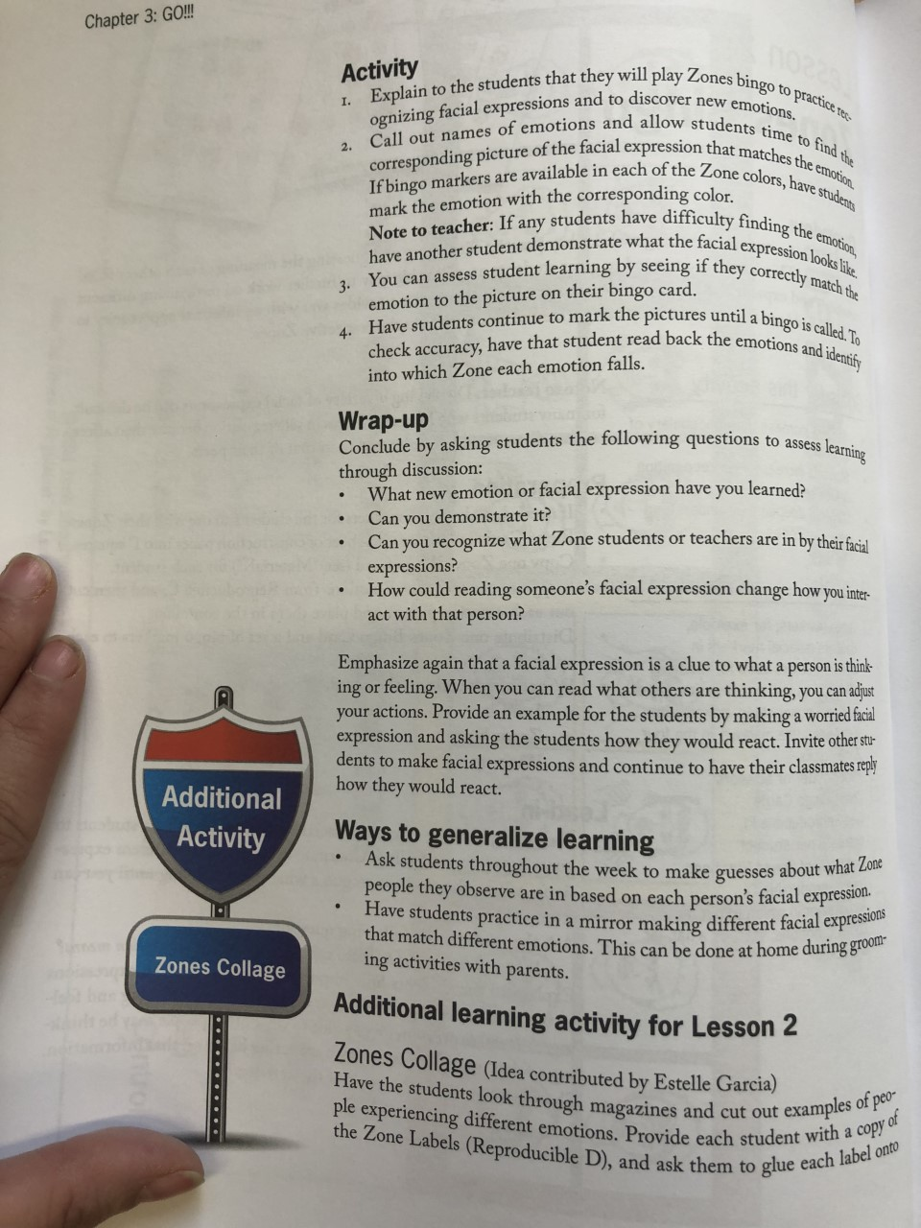
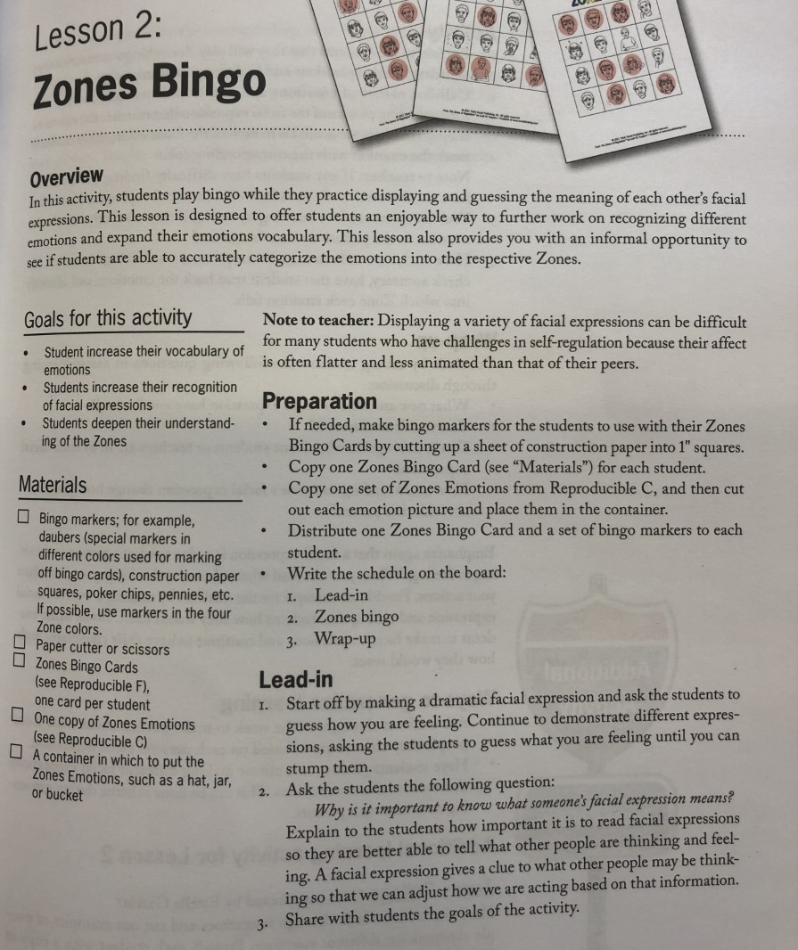
Explicit lesson plans
Reinforce
Consolidate
Home link

Slide 6
Small scale individual interactive mobile board

Slide 7
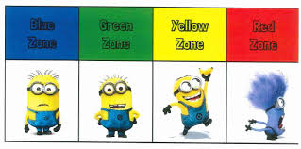
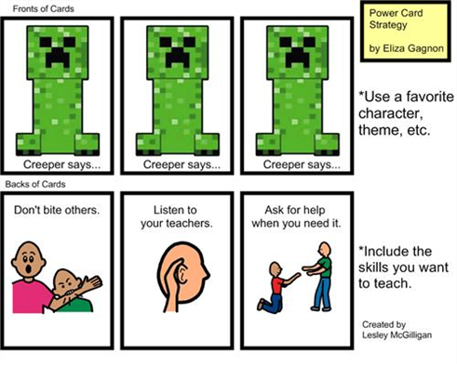
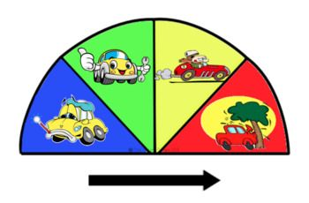
Using characters - examples

Slide 8
Strategies and Techniques

Slide 9
Tracking & Reviewing

Slide 10
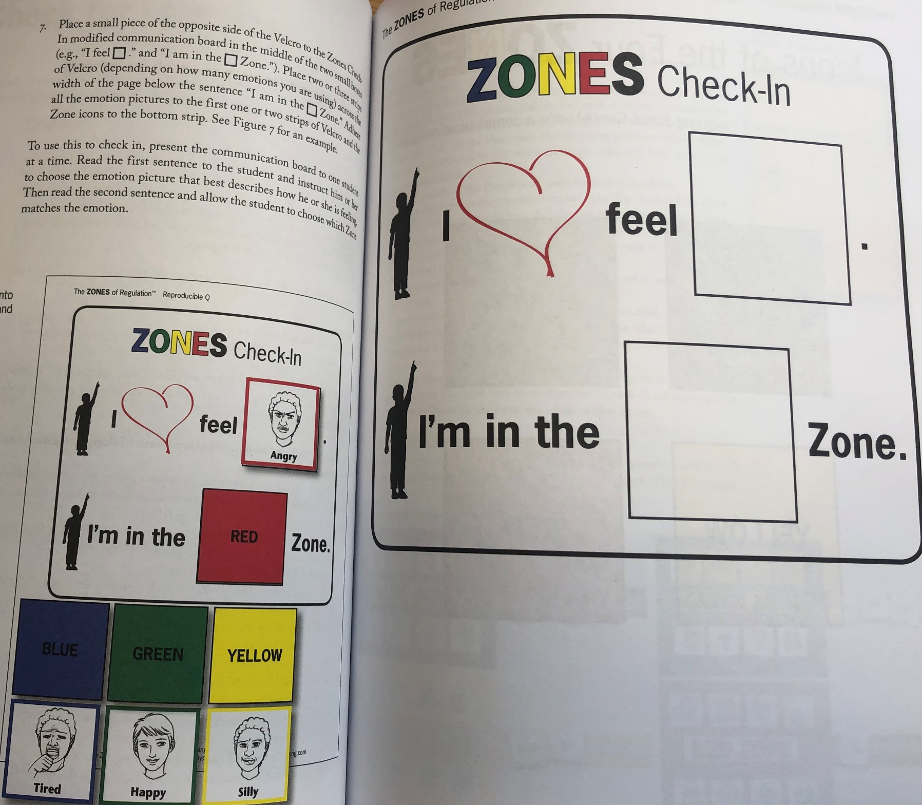
Check in lessons
To gauge understanding
Using emotion cards
Match correct emotion with zone on this communication board

